Slide 1
Student Finance
When is a loan not a loan?
When it's a graduate tax

Slide 2
Compare these…
Version 1
Repay 9% of everything earned above £27,295
Remaining loan wiped after 30 years
Interest charged at RPI + 3%
Version 2 (AKA 'Plan 5')
Repay 9% of everything earned above £25,000
Remaining loan wiped after 40 years
Interest charged at RPI

Slide 3
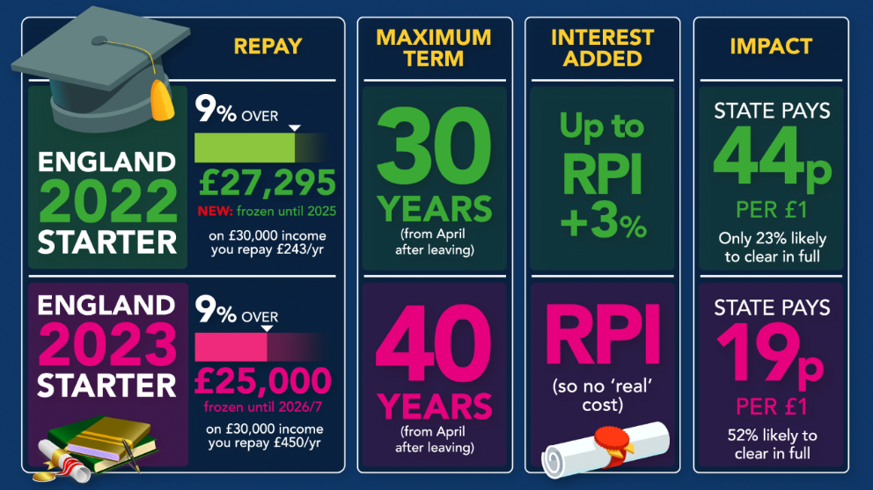
Or summarised like this…
Version 1
Version 2
(Plan 5)

Slide 4
Student Loans Headlines - 1
You DON'T have to pay a penny upfront
It's what you repay that matters, not the size of the loan
You won't repay anything until you're earning over the 'repayment threshold' of £25,000
The loan is wiped after 40 years
Interest rates are set to inflation (RPI), so, in real terms, you won't repay more than you borrowed
Tuition fees won't rise above £9,250 until 2025/26 at the earliest
*currently, until April 2027 then this + RPI

Slide 5
Student Loans Headlines - 2
You can also take a student loan to cover your student living costs
Apply by 19 May to ensure your loan is ready for your start of term
If you're employed, repayments are taken automatically
You can pay off your student loan early, but should you?
Your student loan WON'T go on your credit report…
…but does impact mortgage applications… but not like other debts

Slide 6
Part 1 - Borrowing
There are two parts to the loan - for fees and for living costs
Tuition fees are currently £9,250 per year
Interest is added annually at RPI
Norfolk County Council will pay your tuition fees for you and your student loan will pay them back. You might then pay the student loan back.
The maintenance loan to cover living costs is means tested so the max amount you can borrow varies, see the table on the next slide…
Remember this?!

Slide 7
Maintenance Loan Amounts
 | Min Maintenance Loan | Max Maintenance Loan
Living at home | £3,698 household income ≥£56,910 | £8,400 household income ≤£25,000
Living away but not in London | £4,651 household income ≥£60,836 | £9,978 household income ≤£25,000
Living away, in London | £6,485 household income ≥£67,422 | £13,022 household income ≤£25,000

Slide 8
Part 2 - Paying it Back
*currently
You'll start repayments if/when you earn more than £25,000 per year
Then you'll repay 9% of your gross income above £25,000
You'll continue repaying until the sooner of…
  All repaid
  40 years after you finished university
If you don't earn over £25,000 pa, you don't repay anything
If you haven't repaid it after 40 years, it gets wiped
This amount isn't related to
how much you borrowed
This might be related to
how much you borrowed…
…but this might come sooner

Slide 9
How much you'll pay back each year
Salary | Annual Repayments | % of Salary
£20,000 | £0 | 0%
£30,000 | £450 | 1.5%
£40,000 | £1,350 | 3.375%
£50,000 | £2,250 | 4.5%
£60,000 | £3,150 | 5.25%
£70,000 | £4,050 | ~5.79%
£80,000 | £4,950 | ~6.2%
£90,000 | £5,850 | ~6.5%
£100,000 | £6,750 | 6.75%
Most people will be here
https://www.moneysavingexpert.com/students/student-loans-2023/#livingloan
From here onwards, you'll have more significant financial issues than the student loan…
40% income tax rate
£50k child benefit limit

Slide 10
What You Might Expect
Salary at age 30 (+likely increase later) | Proportion of people likely to repay in full | Average amount repaid over lifetime
£15,000 | 35% | £29,300
£20,000 | 40% | £34,300
£25,000 | 40% | £36,200
£30,000 | 55% | £43,300
£35,000 | 70% | £48,700
£40,000 | 80% | £51,100
£45,000 | 85% | £53,100
£50,000 | 90% | £54,500
£55,000 | 95% | £55,100
£60,000 | 95% | £54,900
£65,000 | 95% | £55,300
£70,000 | 95% | £55,100
With borrowing of £9,250 for tuition fees and £9,706 for living costs, for each year of a three-year course (so £56,868 in total), typically…
https://www.moneysavingexpert.com/students/student-loans-2023/#livingloan

Slide 11
For Example
Three years at university
One year in temporary non-graduate job with salary below £25,000 pa
Then start graduate employment with salary of £26,405pa, increasing by RPI each year + (£2000 per year for 8 years then flat).
Assume RPI of 3%.
https://www.graduate-jobs.com/gco/Booklet/graduate-salary-salaries.jsp

Slide 12
Your turn - how much do each of these graduates repay?
Doctor - starting salary of £29,000 rising to £51,000 in year 5. Then assume constant.
Teacher - starting salary of £28,000 rising to £38,000 in year 6. Then assume constant.
Retail salesperson - starting salary of £24,000 rising to £30,000 if you're lucky. Then assume constant.
https://www.graduate-jobs.com/gco/Booklet/graduate-salary-salaries.jsp

Slide 13
Tips and Tricks
If you get near to repayment completion, keep your payslips as evidence to stop overpayments. The student loan company only makes changes at the end of each tax year but your evidence could stop overpayments sooner.
If RPI is high, then interest on the loan will be high. But credit card / overdraft / unsecured loan rates will be higher so it's still the cheapest loan you'll ever get.

Slide 14
Links
Moneysavingexpert -
https://www.moneysavingexpert.com/news/2022/02/student-finance-loans-changes-education/
https://www.moneysavingexpert.com/students/student-loans-2023/

Slide 15
This Week's Top Tips
https://www.moneysavingexpert.com/latesttip/
7th Feb 2023…
Car insurance up 15% - check NOW if you can save £100s
Top easy-access children's savings 3.75% for age 7-17
UK-born children aged 12 to 20ish had a Child Trust Fund opened in their name with £250 or £500 automatically added.
How much will you need to save for your children's uni?
https://www.moneysavingexpert.com/deals/

